Slide 1
Aging with HIV: The NIH Research Agenda
IAS AIDS 2018: Healthy Aging for PWH
Maureen M. Goodenow, Ph.D.
NIH Associate Director for AIDS Research
Director, NIH Office of AIDS Research
July 25, 2018

Slide 2
Trans-NIH HIV/AIDS Research
OAR is authorized by Congress to plan, coordinate, and evaluate trans-NIH HIV/AIDS-related research and funding
Establish scientific priorities
Allocate the total NIH HIV funding to NIH Institutes
Invest research funds in line with scientific priorities

Slide 3
NIH Office of AIDS Research
NIH HIV/AIDS Research Portfolio
Coordinate
Convene
Catalyze
Largest public investment in HIV/AIDS research
Trans-NIH, multidisciplinary, global
Transcends every area of clinical medicine and basic scientific investigation
Research across the lifespan

Slide 4
Vision for Trans-NIH HIV Research
End the HIV pandemic
AND
Improve the health of People with HIV

Slide 5
OAR Coordinates the Trans-NIH HIV Research Agenda
NIDCR
NICHD
NIGMS
NIEHS
NIDCD
NCATS
NEI
NIBIB
NIAID
NIMH
NIA
ORWH
NINDS
NINR
National Institutes of Health
Office of AIDS Research
NIDDK
NIAAA
NHLBI
NIDA
OBSSR
NCI
NLM
NIAMS
NIMHD
NIAAA
NHGRI
NIMHD
NCCIH
FIC
ORIP
Notes:
NIAAA appears twice on the right side.

Slide 6
NIH Investment in HIV Aging Research
Dollars in Millions
Source: Office of AIDS Research

Slide 7
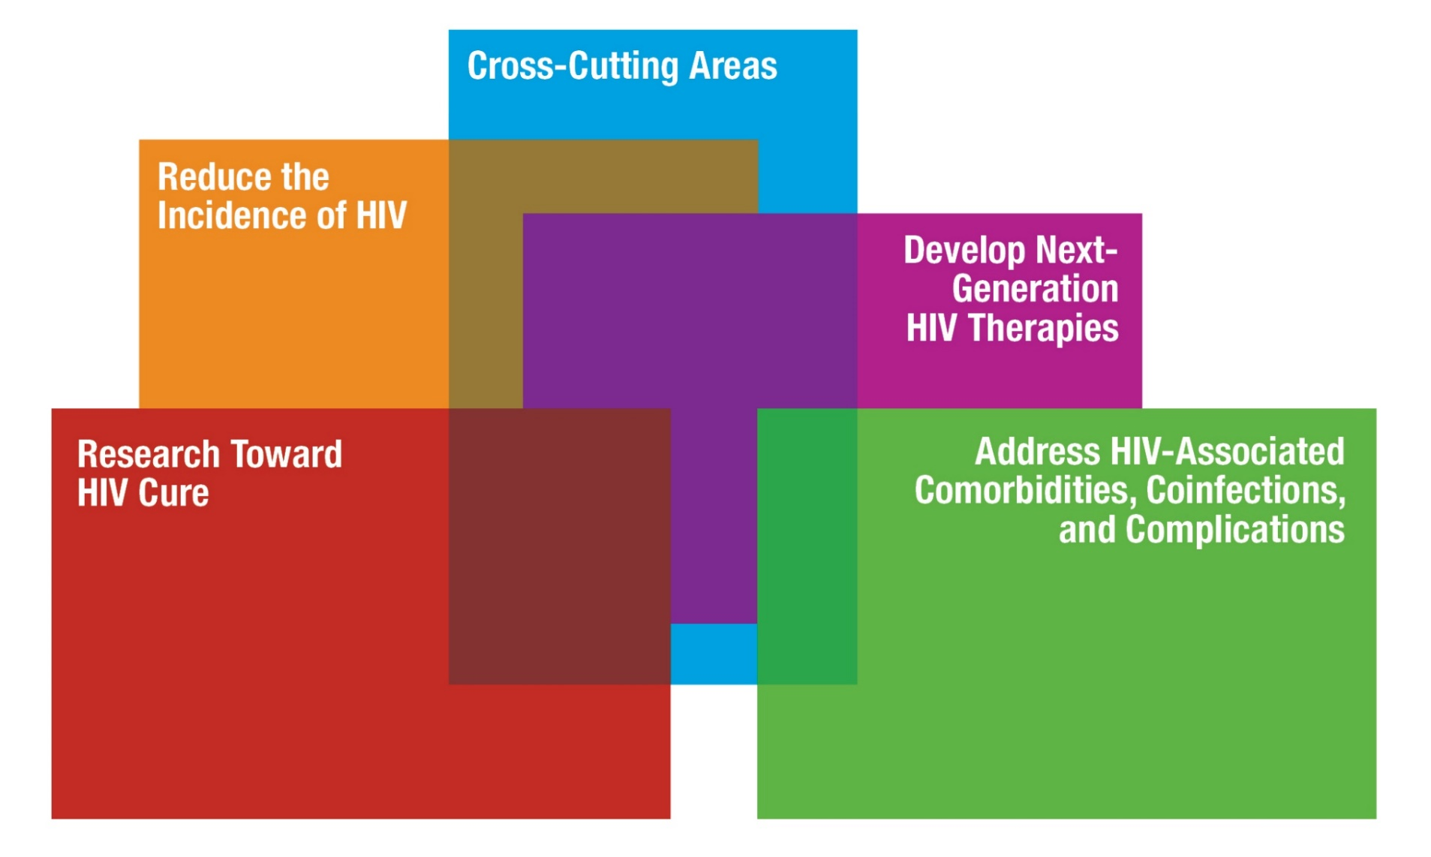
NIH Priorities for HIV and HIV-Related Research
Reduce the Incidence of HIV
• Vaccines
• Pre-exposure Prophylaxis
• Microbicides and MPTs
• HIV Testing
• Treatment as Prevention
• Monoclonal Antibodies
Research Toward HIV Cure
• Sustained ART-free Viral Remission
• Viral Eradication
• Viral Latency and Sanctuaries
• Cure Ethics and Acceptability
Cross-Cutting Areas
• Basic Virology and Immunology
• Behavioral and Social Sciences
• Epidemiology
• Health Disparities
• Information Dissemination
• Implementation Science
• Research Training, Infrastructure, and Capacity Building
Develop Next- Generation HIV Therapies
• Less Toxic and Longer & Lasting ART
• Novel HIV Targets & Inhibitors
• Novel Immune-Based Therapies
• Engagement, Adherence, and Retention in Care
Address HIV-Associated Comorbidities, Coinfections, & Complications
• Coinfections
• Neurologic Complications
• Malignancies
• Cardiovascular Complications
• Mental Illness and Substance Use
• Metabolic Disorders
• Across the Lifespan

Slide 8
2016 Diagnoses of HIV Infection, United States
40
34%
30
Older Adults = 24%
of HIV Diagnoses
21%
20
19%
Diagnoses, %
15%
10
9%
0
13-24
25-34
35-44
45-54
≥55
Age at Diagnosis (yr)
N = 39,782

Slide 9
HIV Care Continuum Across the Life Span
Diagnosed
Receiving care
Retained in Care
Virally suppressed
100
91%
93%
85%
80
71%
67%
67%
60
61%
57%
56%
53%
55%
55%
% of all people living with HIV by age
51%
48%
46%
40
41%
38%
37%
31%
27%
20
0
13-24
25-34
35-44
45-54
55 and over
CDC 2014

Slide 10
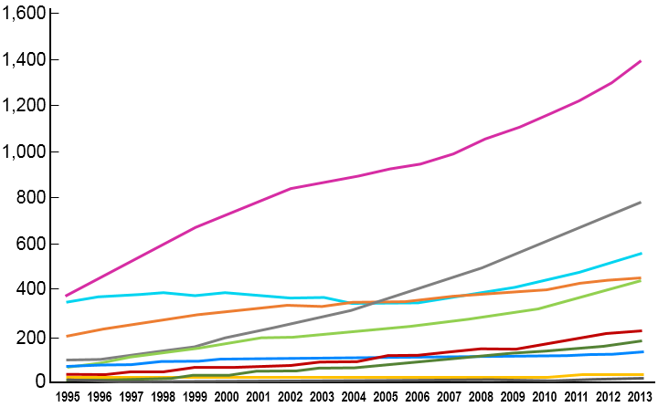
Global Regions: PWH aged 50⁺, 1995-2013 (estimate)
Global Region
Southern Africa
Western and Central Europe and North America
Eastern Africa
Western Africa
Asia and the Pacific
Latin America
Caribbean
Central Africa
Eastern Europe and Central Asia
Middle East and North Africa
Number of PWH aged 50+ (thousands)
Source: UNAIDS 2013 estimates

Slide 11
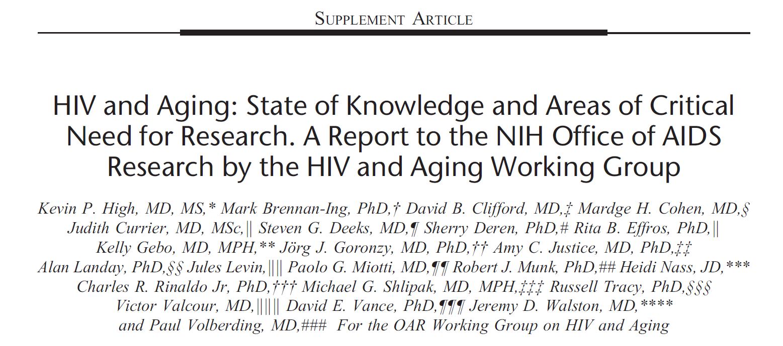
HIV and Aging Working Group NIH Office of AIDS Research
JAIDS July 1, 2012

Slide 12
Research Cohorts Across the Lifespan
Neonates/ Infants (0-2)** | Children (2-9) | Preteens (9-13) | Adolescents (13-18) | Young Adults (18-24) | Adults (24-65) | Seniors (65+)
 |  |  |  | Veterans Aging Cohort Study (VACS) | Veterans Aging Cohort Study (VACS) | Veterans Aging Cohort Study (VACS)
**
** pregnant/postpartum

Slide 13
Clinical Trial Networks Across the Lifespan
Neonates/ Infants (0-2) | Children (2-9) | Preteens (9-13) | Adolescents (13-18) | Young Adults (18-24) | Adults (24-65) | Seniors (65+)
**
** pregnant/postpartum

Slide 14
NIH Partnership between HIV and Aging
Centers for AIDS Research
[CFARs]
Claude D. Pepper Older American Independence Centers
Interdisciplinary research on aging with HIV
Shared research platform
Pilot projects

Slide 15
Multidisciplinary Studies
Funding opportunities encourage applications at the intersection of HIV and aging
Neurological and neurocognitive disorders: Alzheimer’s dementia or HAND (RFA-AG-18-023)
Biological, clinical and socio-behavioral aspects
Approaches for testing, prevention, treatment of HIV infection
Management of comorbidities, coinfections and complications

Slide 16
US HIV Research Pipeline [partial]
Basic
Clinical
Translational
Implementation
Public Health
NIH
CDC
CMS
DoD
BARDA
FDA
HRSA
PEPFAR
SAMSHA
Notes:
Revise to include USAID. Verify arrow placement for each agency.

Slide 17
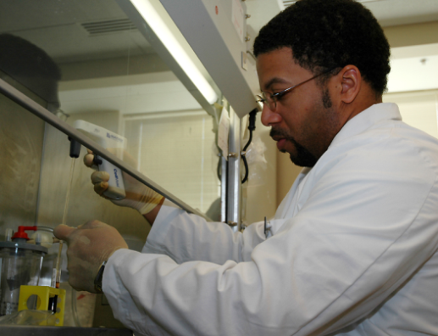
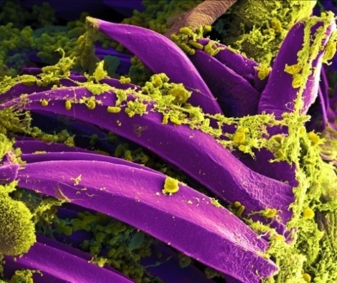
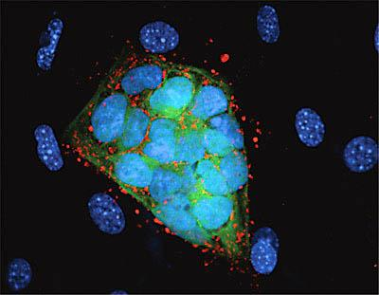
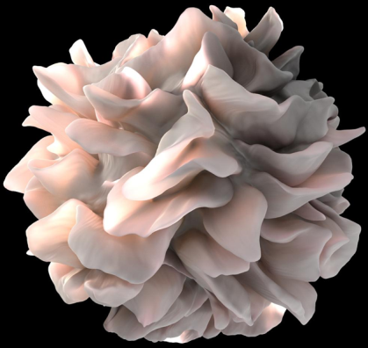
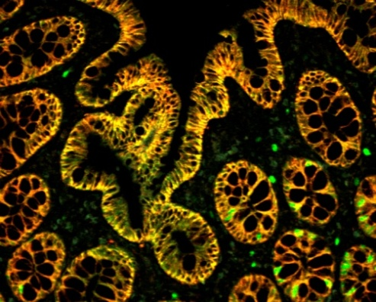
NIH…
Turning Discovery Into Health
17

